Slide 1
Bloom:
Big Systems,
Small Programs
Neil Conway
UC Berkeley

Slide 2

Distributed Computing

Slide 3

Programming Languages

Slide 4
Data prefetching
Register allocation
Loop unrolling
Function inlining
Optimization
Global coordination, waiting
Caching, indexing
Replication, data locality
Partitioning, load balancing
Notes:
Current tech: data movement up/down memory hierarchy
What we want: data movement across machines, data centers, programs

Slide 5
Undeclared variables
Type mismatches
Sign conversion mistakes
Warnings
Replica divergence
Inconsistent state
Deadlocks
Race conditions

Slide 6
Stack traces
gdb
Log files, printf
Debugging
Full stack visualization, analytics
Consistent global snapshots
Provenance analysis
Notes:
How much time is spent groveling through log files! Is this really the best that we can do?

Slide 7
Developer productivity is a
major unsolved problem
in distributed computing.
Notes:
We know how to *build* distributed systems; but we don’t yet know how to make distributed programming *efficient*.

Slide 8

We can do better!
… provided we’re willing to make changes.

Slide 9
Design Principles
Notes:
First, design principles. Then, a practical language.

Slide 10
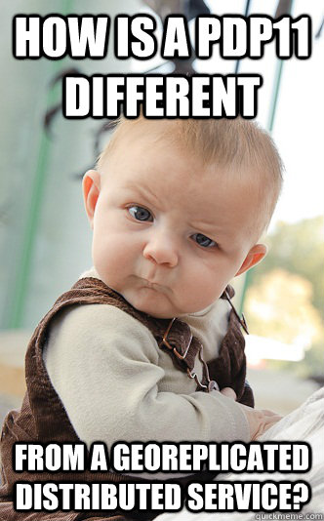

Slide 11

Centralized Computing
Predictable latency
No partial failure
Single clock
  Global event order

Slide 12
Taking Order For Granted
Data | (Ordered) array of bytes
Compute | (Ordered) sequence of instructions
Global event
order

Slide 13
Distributed Computing
Unpredictable latency
Partial failures
No global event order

Slide 14
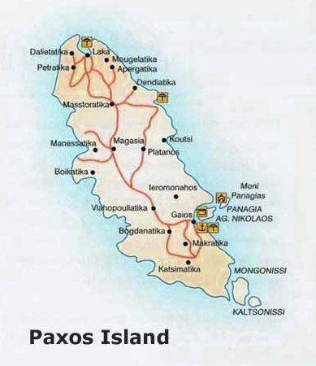
Alternative #1:
Enforce global event order at all nodes
(“Strong Consistency”)

Slide 15
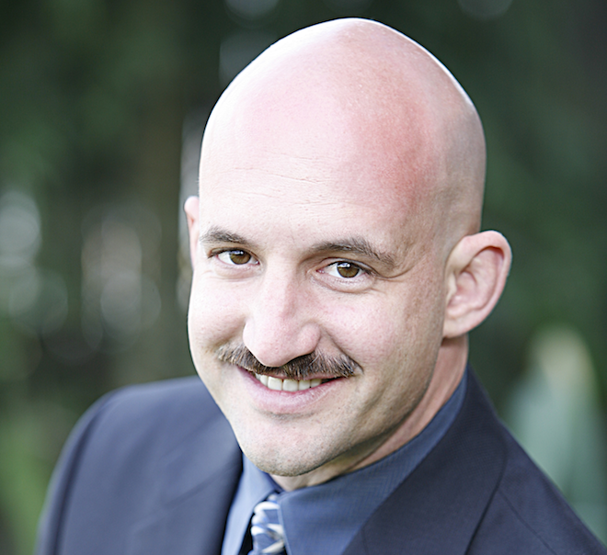
Alternative #1:
Enforce global event order at all nodes
(“Strong Consistency”)
Problems:
Availability (CAP)
Latency

Slide 16
Alternative #2:
Ensure correct behavior
for any network order
(“Weak Consistency”)

Slide 17
Alternative #2:
Ensure correct behavior
for any network order
(“Weak Consistency”)
Problem:
With traditional languages, this is very difficult.

Slide 18
The “ACID 2.0” Pattern
Associativity:
X ○ (Y ○ Z) = (X ○ Y) ○ Z
“batch tolerance”
Commutativity:
X ○ Y = Y ○ X
“reordering tolerance”
Idempotence:
X ○ X = X
“retry tolerance”

Slide 19
“When I see patterns in my programs, I consider it a sign of trouble … [they are a sign] that I'm using abstractions that aren't powerful enough.”
—Paul Graham

Slide 20

Bounded Join Semilattices
A triple hS,t,?i such that:
  S is a set
  t is a binary operator (“least upper bound”)
    Induces a partial order on S: x ·_{S} y if x t y = y
    Associative, Commutative, and Idempotent
  8x 2 S: ? t x = x

Slide 21
Bounded Join Semilattices
Lattices are objects that grow over time.
An interface with an
ACID 2.0 merge() method
  Associative
  Commutative
  Idempotent

Slide 22
Time
Set
(Merge = Union)
Increasing Int
(Merge = Max)
Boolean
(Merge = Or)

Slide 23


CRDTs: Convergent Replicated Data Types
  e.g., registers, counters, sets, graphs, trees
Implementations:
  Statebox
  Knockbox
  riak_dt

Slide 24
Lattices represent
disorderly data.
How can we represent disorderly computation?

Slide 25
f : S→T is a monotone function iff:
8a,b 2 S : a ·_{S} b ) f(a) ·_{T} f(b)

Slide 26
Time
Monotone function:
set → increase-int
Monotone function:
increase-int → boolean
size()
>= 3
Set
(Merge = Union)
Increasing Int
(Merge = Max)
Boolean
(Merge = Or)

Slide 27

Consistency
As
Logical
Monotonicity

Slide 29
Notes:
Working on tool support: e.g., coordination synthesis.

Slide 30
Notes:
Working on tool support: e.g., coordination synthesis.

Slide 31
Case Study

Slide 37
Questions
Will cart replicas eventually converge?
  “Eventual Consistency”
What will client observe on checkout?
  Goal: checkout reflects all session activity
To achieve #1 and #2, how much ordering is required?

Slide 38
Design #1: Mutable State
Add(item x, count c):
Remove(item x, count c):
if kvs[x] exists:
old = kvs[x]
kvs.delete(x)
else
old = 0
kvs[x] = old + c
if kvs[x] exists:
old = kvs[x]
kvs.delete(x)
if old > c
kvs[x] = old – c
Non-monotonic!

Slide 39
Non-monotonic!
Conclusion:
Every operation might
require coordination!

Slide 40

Design #2: “Disorderly”
Add(item x, count c):
Checkout():
Add x,c to add_log
Group add_log by
item ID; sum counts.
Group del_log by
item ID; sum counts.
For each item, subtract deletes from adds.
Remove(item x, count c):
Add x,c to del_log
Non-monotonic!

Slide 41
Monotonic
Conclusion:
Replication is safe;
might need to
coordinate on checkout
Notes:
Example: what if checkout arrives before a cart operation?

Slide 42
Takeaways
Avoid: mutable state update
Prefer: immutable data, monotone growth
Major difference in coordination cost!
  Coordinate once per operation vs.
  Coordinate once per checkout
We’d like a type system for monotonicity

Slide 43
Language Design

Slide 44

Disorderly Programming
Order-independent: default
Order dependencies: explicit
Order as part of the design process
Tool support
  Where is order needed? Why?

Slide 45
The Disorderly Spectrum
ASM
Java
Haskell
Bloom
C
Lisp, ML
SQL, LINQ,
Datalog
High-level
“Declarative”
Powerful optimizers

Slide 46
Processes that
communicate via
asynchronous
message passing
Bloom ≈ declarative agents
Each process
has a local
database
Logical rules describe
computation and
communication (“SQL++”)
Notes:
No shared state.

Slide 47
Each agent has a database of values that changes over time.
All values have a location
and timestamp.
Notes:
“Database of values” is like “Relational database” for the purposes of this talk – a set of tables containing tuples.
Over time, how does the database change, and how do the values at one node effect the values at another?

Slide 48
If RHS is true (SELECT …)
Then LHS is true
(INTO lhs)
left-hand-side <= right-hand-side
When and where
is the LHS true?

Slide 49
Temporal Operators
Same location,
same timestamp
Same location,
next timestamp
Different location,
non-deterministic timestamp
<=
Computation
<+
<-
Persistence
Deletion
<~
Communication

Slide 50
Observe
Compute
Act

Slide 51
Our First Program:
PubSub

Slide 53
class Hub
include Bud
state do
channel :subscribe, [:@addr, :topic, :client]
channel :pub, [:@addr, :topic, :val]
channel :event, [:@addr, :topic, :val]
table :sub, [:addr, :topic]
end
bloom do
sub <= subscribe {|s| [s.client, s.topic]}
event <~ (pub * sub).pairs(:topic => :topic) {|p,s|
[s.addr, p.topic, p.val]
}
end
end
Ruby DSL

Slide 54
class Hub
include Bud
state do
channel :subscribe, [:@addr, :topic, :client]
channel :pub, [:@addr, :topic, :val]
channel :event, [:@addr, :topic, :val]
table :sub, [:addr, :topic]
end
bloom do
sub <= subscribe {|s| [s.client, s.topic]}
event <~ (pub * sub).pairs(:topic => :topic) {|p,s|
[s.addr, p.topic, p.val]
}
end
end
State declarations

Slide 55
class Hub
include Bud
state do
channel :subscribe, [:@addr, :topic, :client]
channel :pub, [:@addr, :topic, :val]
channel :event, [:@addr, :topic, :val]
table :sub, [:addr, :topic]
end
bloom do
sub <= subscribe {|s| [s.client, s.topic]}
event <~ (pub * sub).pairs(:topic => :topic) {|p,s|
[s.addr, p.topic, p.val]
}
end
end
Rules

Slide 56
class Hub
include Bud
state do
table :sub, [:client, :topic]
channel :subscribe, [:@addr, :topic, :client]
channel :pub, [:@addr, :topic, :val]
channel :event, [:@addr, :topic, :val]
end
bloom do
sub <= subscribe {|s| [s.client, s.topic]}
event <~ (pub * sub).pairs(:topic => :topic) {|p,s|
[s.addr, p.topic, p.val]
}
end
end
Schema
Persistent state: set
of subscriptions

Slide 57
class Hub
include Bud
state do
table :sub, [:client, :topic]
channel :subscribe, [:@addr, :topic, :client]
channel :pub, [:@addr, :topic, :val]
channel :event, [:@addr, :topic, :val]
end
bloom do
sub <= subscribe {|s| [s.client, s.topic]}
event <~ (pub * sub).pairs(:topic => :topic) {|p,s|
[s.addr, p.topic, p.val]
}
end
end
Network input, output
Destination address

Slide 58
class Hub
include Bud
state do
table :sub, [:client, :topic]
channel :subscribe, [:@addr, :topic, :client]
channel :pub, [:@addr, :topic, :val]
channel :event, [:@addr, :topic, :val]
end
bloom do
sub <= subscribe {|s| [s.client, s.topic]}
event <~ (pub * sub).pairs(:topic => :topic) {|p,s|
[s.client, p.topic, p.val]
}
end
end
Remember subscriptions
Notes:
Rules can be reordered.

Slide 59
class Hub
include Bud
state do
table :sub, [:client, :topic]
channel :subscribe, [:@addr, :topic, :client]
channel :pub, [:@addr, :topic, :val]
channel :event, [:@addr, :topic, :val]
end
bloom do
sub <= subscribe {|s| [s.client, s.topic]}
event <~ (pub * sub).pairs(:topic => :topic) {|p,s|
[s.client, p.topic, p.val]
}
end
end
Send events to subscribers
Join key
Join (as in SQL)
Notes:
Rules can be reordered.

Slide 60
“Push-Based”
Persistent
State
Ephemeral
Events

Slide 61
“Pull-Based”
Ephemeral
Events
Persistent
State

Slide 62
class Hub
include Bud
state do
table :sub, [:client, :topic]
channel :subscribe, [:@addr, :topic, :client]
channel :pub, [:@addr, :topic, :val]
channel :event, [:@addr, :topic, :val]
end
bloom do
sub <= subscribe {|s| [s.client, s.topic]}
event <~ (pub * sub).pairs(:topic => :topic) {|p,s|
[s.client, p.topic, p.val]
}
end
end

Slide 63
class HubPull
include Bud
state do
table :pub, [:topic, :val]
channel :publish, [:@addr, :topic, :val]
channel :sub, [:@addr, :topic, :client]
channel :event, [:@addr, :topic, :val]
end
bloom do
pub <= publish {|p| [p.topic, p.val]}
event <~ (pub * sub).pairs(:topic => :topic) {|p,s|
[s.client, p.topic, p.val]
}
end
end

Slide 64
Suppose we keep only the most recent message for each topic (“last writer wins”).
Publish → Put
Subscribe → Get
Event → Reply
Pub → DB
Topic → Key
Rename:

Slide 65
class KvsHub
include Bud
state do
table :db, [:key, :val]
channel :put, [:@addr, :key, :val]
channel :get, [:@addr, :key, :client]
channel :reply, [:@addr, :key, :val]
end
bloom do
db <+ put {|p| [p.key, p.val]}
db <- (db * put).lefts(:key => :key)
reply <~ (db * get).pairs(:key => :key) {|d,g|
[g.client, d.key, d.val]
}
end
end
Update = delete + insert

Slide 68
class KvsHub
include Bud
state do
table :db, [:key, :val]
channel :put, [:@addr, :key, :val]
channel :get, [:@addr, :key, :client]
channel :reply, [:@addr, :key, :val]
end
bloom do
db <+ put {|p| [p.key, p.val]}
db <- (db * put).lefts(:key => :key)
reply <~ (db * get).pairs(:key => :key) {|d,g|
[g.client, d.key, d.val]
}
end
end

Slide 69
Takeaways
Bloom:
Concise, high-level programs
State update, asynchrony, and non-monotonicity are explicit in the syntax
Design Patterns:
Communication vs. Storage
Queries vs. Data
Push vs. Pull
Actually
not so
different!
Notes:
Stream processing vs. Databases

Slide 70
Conclusion
Traditional languages are not a good fit for modern distributed computing
Principle: Disorderly programs for disorderly networks
Practice: Bloom
  High-level, disorderly, declarative
  Designed for distribution

Slide 71
Thank You!
Twitter: @neil_conway
gem install bud
http://www.bloom-lang.net
Collaborators:
Peter Alvaro
Emily Andrews
Peter Bailis
David Maier
Bill Marczak
Joe Hellerstein
Sriram Srinivasan

