Slide 1
Disorderly Distributed Programming with Bloom
Emily Andrews, Peter Alvaro, Peter Bailis,
Neil Conway, Joseph M. Hellerstein,
William R. Marczak
UC Berkeley
David Maier
Portland State University

Slide 2

Conventional Programming

Slide 3

Distributed Programming

Slide 4
Problem:
Different nodes might perceive
different event orders

Slide 5
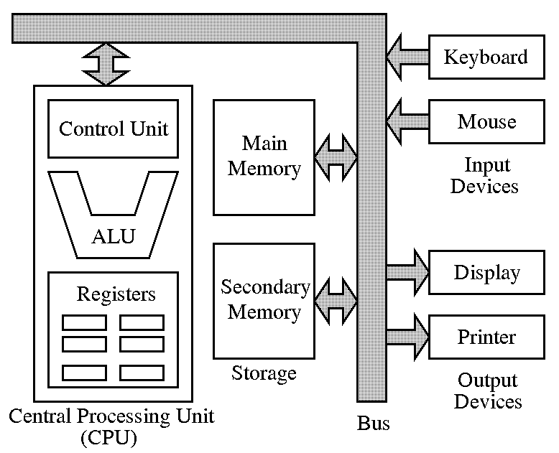
Taking Order For Granted
Data | (Ordered) array of bytes
Compute | (Ordered) sequence of instructions
Writing order-sensitive
programs is too easy!

Slide 6

Alternative #1:
Enforce consistent event order at all nodes
Extensive literature:
  Replicated state machines
  Consensus, coordination
  Group communication
  “Strong Consistency”

Slide 7
Alternative #1:
Enforce consistent event order at all nodes
Problems:
  Latency
  Availability

Slide 8
Alternative #2:
Analyze all event orders,
ensure correct behavior

Slide 9

Alternative #2:
Analyze all event orders to ensure correct behavior
Problem:
That is really,
really hard

Slide 10
Alternative #3:
Write order-independent (“disorderly”) programs

Slide 11
Alternative #3:
Write order-independent (“disorderly”) programs
Questions:
How to write such programs?
What can we express in a disorderly way?

Slide 12
Disorderly Programming
Program analysis: CALM
  Where is order needed? And why?
Language design: Bloom
  Order-independent by default
  Ordering is possible but explicit
Mixing order and disorder: Blazes
  Order synthesis and optimization
Algebraic programming

Slide 13

CALM:
Consistency
As
Logical
Monotonicity

Slide 14
History
Roots in UCB database research (~2005)
  High-level, declarative languages for network protocols & distributed systems
  “Small programs for large clusters” (BOOM)
Distributed programming with logic
  State: sets (relations)
  Computation: deductive rules over sets
    SQL, Datalog, etc.

Slide 15

Observation:
Much of Datalog is
order-independent.

Slide 16
Monotonic Logic
As input set grows, output set does not shrink
  “Mistake-free”
Order independent
e.g., map, filter, join, union, intersection
Non-Monotonic Logic
New inputs might invalidate previous outputs
Order sensitive
e.g., aggregation, negation

Slide 17
Agents learn strictly more knowledge over time
Different learning order, same final outcome
Deterministic outcome,
despite network non-determinism
(“Confluent”)

Slide 18
Confluent Programming

Slide 19
Consistency
As
Logical
Monotonicity
CALM Analysis (CIDR’11)
Monotone programs are deterministic
Simple syntactic test for monotonicity
Result: Whole-program static analysis for
eventual consistency
Notes:
Big deal!! Contrast with CRDT guarantees.

Slide 20
CALM: Beyond Sets
Monotonic logic: growing sets
  Partial order: set containment
Expressive but sometimes awkward
  Timestamps, version numbers, threshold tests, directories, sequences, …

Slide 21
Challenge:
Extend monotone logic to
support other flavors of
“growth over time”

Slide 22
hS,t,?i is a bounded join semilattice iff:
  S is a set
  t is a binary operator (“least upper bound”)
    Induces a partial order on S: x ·_{S} y if x t y = y
    Associative, Commutative, and Idempotent
      “ACID 2.0”
    Informally, LUB is “merge function” for S
  ? is the “least” element in S
    8x 2 S: ? t x = x

Slide 23
Time
Set
(t = Union)
Increasing Int
(t = Max)
Boolean
(t = Or)

Slide 24
f : S→T is a monotone function iff:
8a,b 2 S : a ·_{S} b ) f(a) ·_{T} f(b)

Slide 25
Time
Monotone function:
set → increase-int
Monotone function:
increase-int → boolean
size()
>= 3
Set
(t = Union)
Increasing Int
(t = Max)
Boolean
(t = Or)

Slide 26

The Bloom
Programming
Language

Slide 27
Bloom Basics
Communication | Message passing between agents
State | Lattices
Computation | Functions over lattices
“Disorderly” Computation | Monotone functions

Slide 28
Bloom Operational Model

Slide 29
Quorum Vote
QUORUM_SIZE = 5
RESULT_ADDR = "example.org"
class QuorumVote
include Bud
state do
channel :vote_chn, [:@addr, :voter_id]
channel :result_chn, [:@addr]
lset :votes
lmax :vote_cnt
lbool :got_quorum
end
bloom do
votes <= vote_chn {|v| v.voter_id}
vote_cnt <= votes.size
got_quorum <= vote_cnt.gt_eq(QUORUM_SIZE)
result_chn <~ got_quorum.when_true { [RESULT_ADDR] }
end
end
Annotated Ruby class
Communication interfaces:
non-deterministic delivery order!
Program state
Lattice state declarations
Accumulate votes
into set
Merge at non-deterministic
future time
Monotone function: set → max
Monotone function: max → bool
Program logic
Merge new votes together
with stored votes (set LUB)
Merge using lmax LUB
Threshold test on bool (monotone)

Slide 30
Some Features of Bloom
Library of built-in lattice types
  Booleans, increasing/decreasing integers, sets, multisets, maps, sequences, …
  API for defining custom lattice types
Support both relational-style rules and functions over lattices
Model-theoretic semantics (“Dedalus”)
  Logic + state update + async messaging

Slide 31
Ongoing Work
Runtime
  Current implementation: Ruby DSL
  Next generation: JavaScript, code generation
    Also target JVM, CLR, MapReduce
Tools
  BloomUnit: Distributed testing / debugging
  Verification of lattice type implementations
Software stack
  Concurrent editing, version control
  Geo-replicated consistency control

Slide 32
CRDTs vs. Bloom
Similarities
  Focus on commutative operations
  Formalized via join semilattices
    Monotone functions → composition of CRDTs
  Similar design patterns (e.g., need for GC)
Differences
  Approach: language design vs. ADTs
  Correctness: confluence vs. convergence
    Confluence is strictly stronger
    CRDT “query” is not necessarily monotone
    CRDTs more expressive?

Slide 33
Ongoing Work
Runtime
  Current implementation: Ruby DSL
  Next generation: JavaScript, code generation
    Also target JVM, CLR, MapReduce
Tools
  BloomUnit: Distributed testing / debugging
  Verification of lattice type implementations
Software stack
  Built: Paxos, HDFS, 2PC, lock manager, causal delivery, distributed ML, shopping carts, routing, task scheduling, etc.
  Working on:
    Concurrent editing, version control
    Geo-replicated consistency control

Slide 34

Blazes:
Intelligent
Coordination
Synthesis

Slide 35
Mixing Order and Disorder
Can these ideas scale to large systems?
  Ordering can rarely be avoided entirely
Make order part of the design process
  Annotate modules with ordering semantics
  If needed, coordinate at module boundaries
Philosophy
  Start with what we’re given (disorder)
  Create only what we need (order)

Slide 36
Tool Support
Path analysis
  How does disorder flow through a program?
  Persistent vs. transient divergence
Coordination synthesis
  Add “missing” coordination logic automatically

Slide 37
Coordination Synthesis
Coordination is costly
  Help programmers use it wisely!
Automatic synthesis of coordination logic
Customize coordination code to match:
  Application semantics (logical)
  Network topology (physical)

Slide 38
Application Semantics
Common pattern: “sessions”
  (Mostly) independent, finite duration
During a session:
  Only coordinate among participants
After a session:
  Session contents are sealed (immutable)
  Coordination is unnecessary!

Slide 39
Sealing
Non-monotonicity → arbitrary change
  Very conservative!
Common pattern in practice:
  Mutable for a short period
  Immutable forever after
Example: bank accounts at end-of-day
Example: distributed GC
  Once (global) refcount = 0, remains 0

Slide 40
Affinity
Network structure affects coordination cost
Example:
  m clients, n storage servers
  1 client request → many storage messages
  Possible strategies:
    Coordinate among (slow?) clients
    Coordinate among (fast?) servers
Related: geo-replication, intra- vs. inter-DC coordination, “sticky” sessions

Slide 41

Algebraic
Programming

Slide 42
Adversarial Programming
A confluent program must behave correctly for any network schedule
  Network as “adversary”
What if we could control the network?
  Schedule only influences performance,
  not correctness
  Sounds like an optimizer!

Slide 43
Algebra vs. Ordering
The developer writes two programs:
Algebra defines program behavior
  Guaranteed to be order independent
  Language: high-level, declarative
Ordering Spec controls input order
  Ordering, batching, timing
  Language: arbitrary (e.g., imperative)
    Need not be deterministic

Slide 44
Benefits
Separate correctness and performance
  Might be developed independently!
Wide range of freedom for optimization
  No risk of harming correctness
    Randomness, batching, parallelism,
    CPU affinity, data locality, …
  Auto-tuning/synthesis of ordering spec?

Slide 45
Examples
Quicksort
Algebra:
  Input: values to sort, pivot elements
  Output: sorted list
Ordering Spec:
  Ordering of pivots
Matrix Multiplication
Algebra:
  Input: sub-matrices
  Output: result of matrix multiply
Ordering Spec:
  Tiling
    i.e., division of input matrices into pieces

Slide 46
In a distributed system,
Order is precious!
Let’s stop taking it for granted.

Slide 47
Recap
The network is disorderly – embrace it!
How can we write disorderly programs?
  State: join semilattices
  Computation: monotone functions
When order is necessary, use it wisely
  A program’s ordering requirements should be a first-class concern!

Slide 48
Thank You!
Questions Welcome

